Slide 1
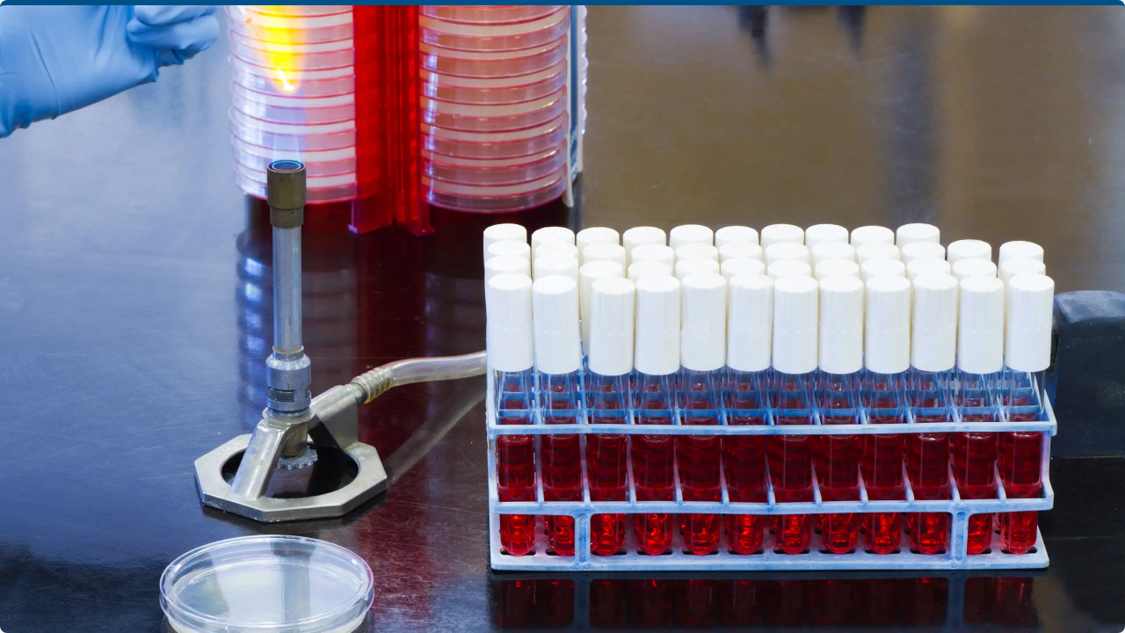

Data-Driven Corrosion
Inhibitor Modeling
Pipeline Progress Report

Slide 2


Project Overview
Goal
Predict Inhibition Efficiency (IE) of surfactant-based inhibitors to recommend optimal formulations.
Expanded Data Structure
~300 Lab Tests across three distinct media:
•
HCl: Low pH ≈ 0.5
•
NaCl: Medium pH ≈ 4.9
•
CPS (Concrete Pore Solution): High pH ≈ 12.5
*Dataset now includes a specific 'medium' column and updated pH values.

Slide 3






Preprocessing Pipeline
Cleaning & Logic
Imputation & Scaling
Splitting
Dropped redundant columns and normalized "Unnamed" entries. Scaled IE using Active Agent (IE = IE × AA / 100).
Applied train-only mean imputation for numeric features followed by standard scaling (StandardScaler).
Data split into Train (70%), Validation (15%), and Test (15%). Saved as cleaned artifacts in data/processed.

Slide 4
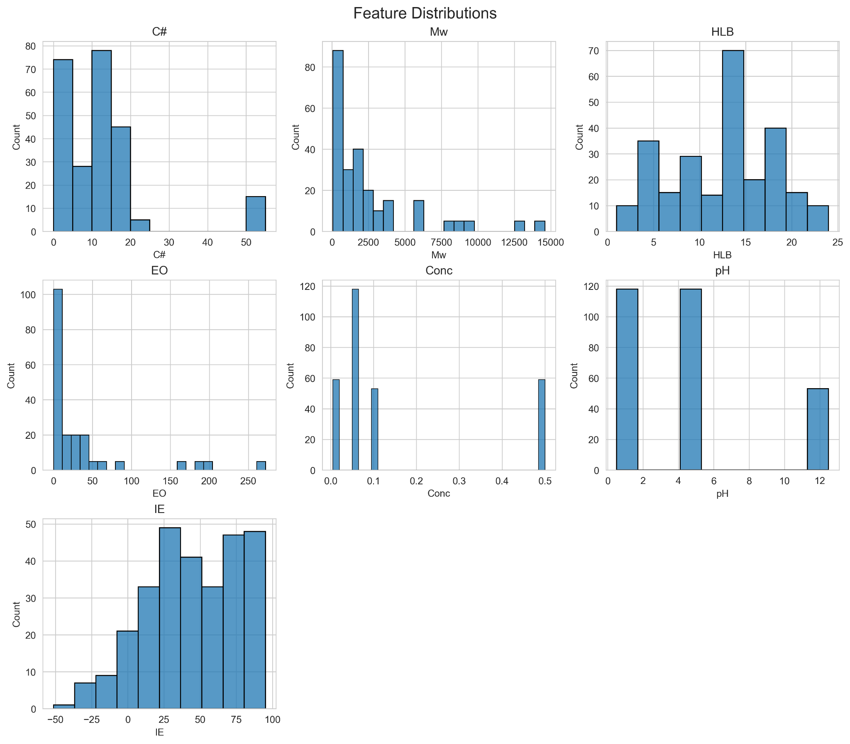

EDA: Distribution Insights
Key Observations
•
Inhibition Efficiency (IE): Ranges broadly from -52% to 95%. Distinct shifts in IE distributions are visible across the three different media.
•
pH Clustering: Unlike the previous dataset, pH now clusters clearly at three poles: 0.5 (HCl), 4.9 (NaCl), and 12.5 (CPS), driving the segmentation of the analysis.

Slide 5
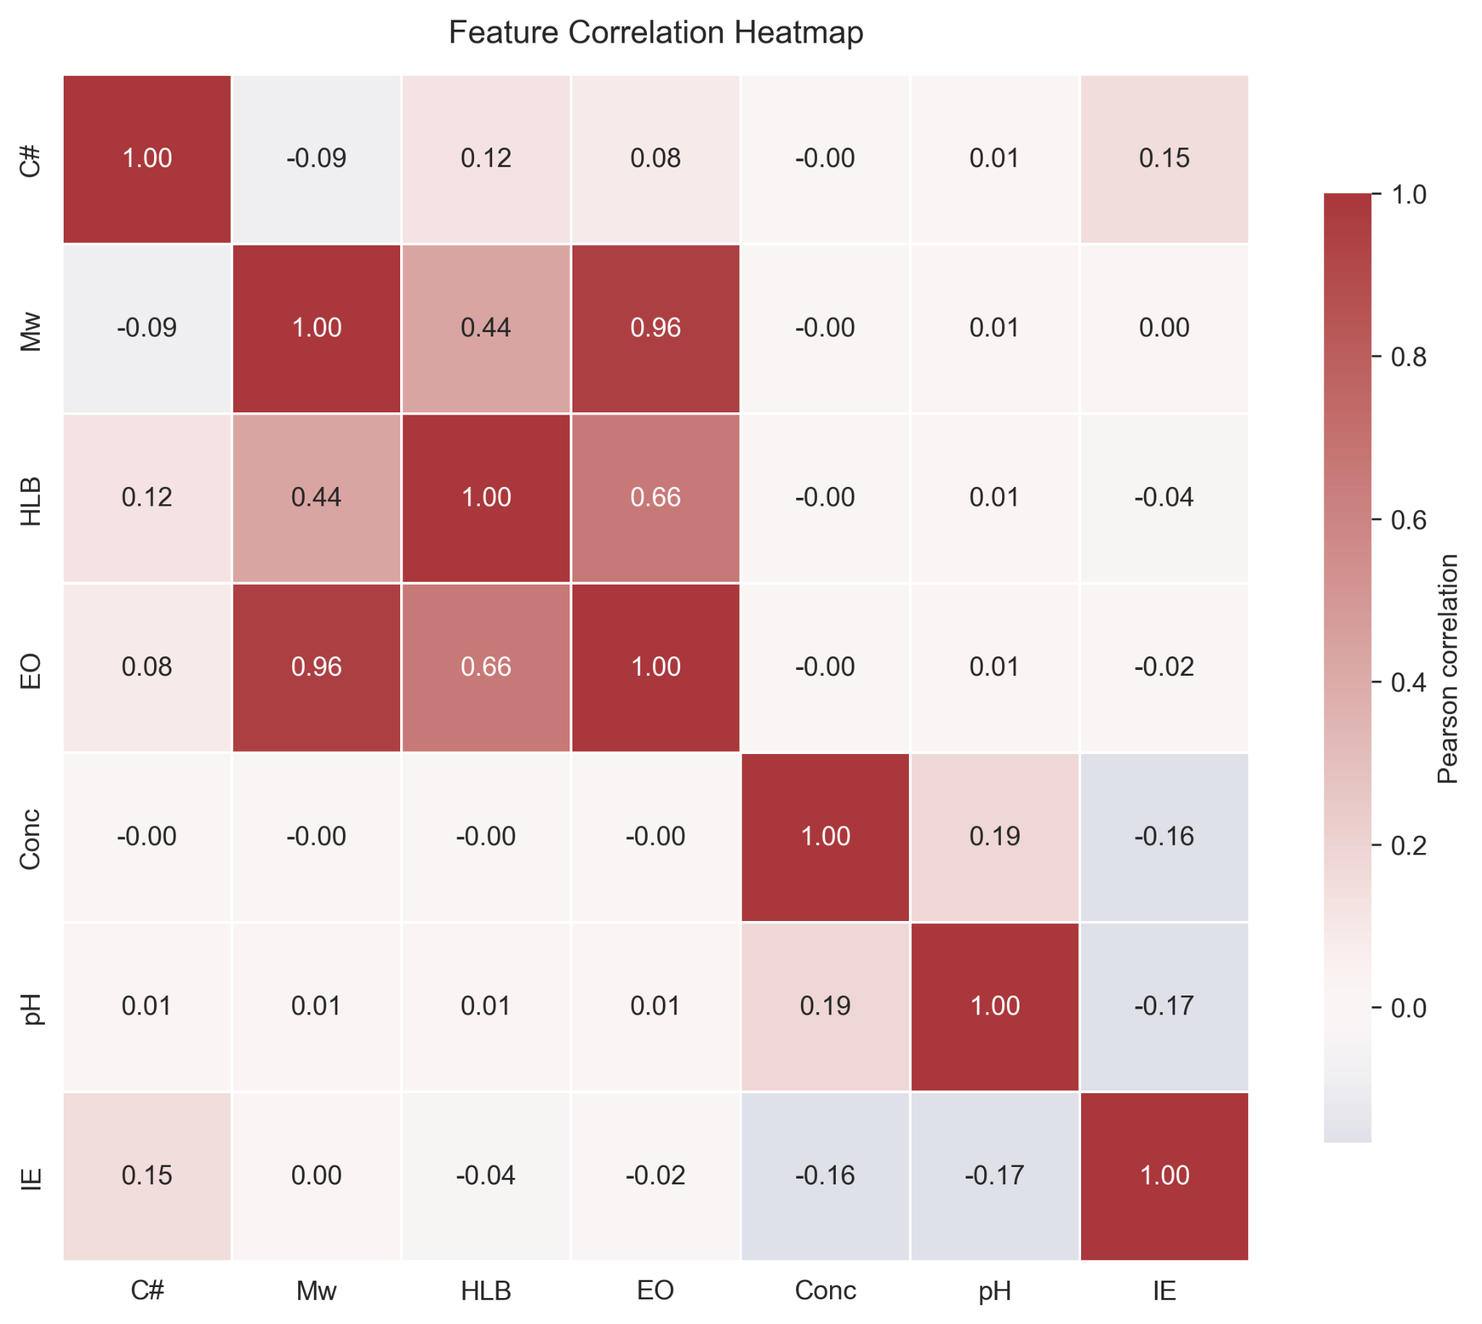
EDA: Correlations
Heatmap Findings
•
pH & IE Link: A strong correlation exists between low pH and higher Inhibition Efficiency.
•
Concentration: Exhibits a mild negative relationship with IE.
•
Other Features: Show moderate to no linear correlation, suggesting that complex non-linear models (like Random Forest) are required to capture these interactions.

Slide 6


Feature Engineering & Access
Canonical Feature Set
Pipeline Integration
The feature set has been updated to explicitly include pH as a variable driver:
features.load_splits()
This function creates a unified interface to grab processed (X, y) splits, ensuring that the model always trains on the most up-to-date data artifacts.
Carbon # (C#)
Molecular Weight
HLB Value
Ethylene Oxide
Concentration
pH Level

Slide 7
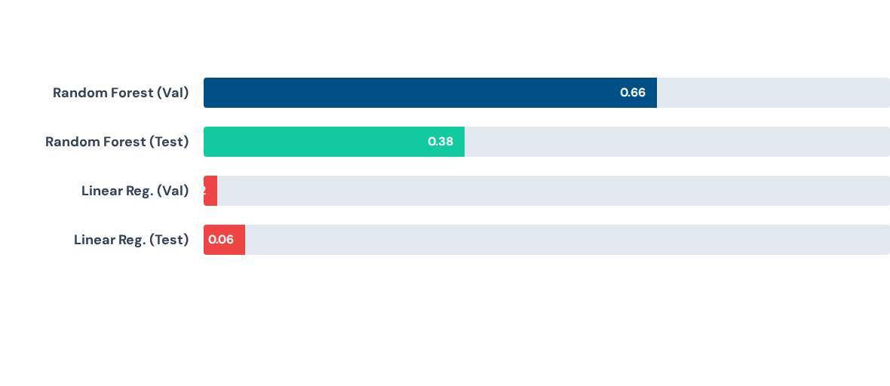
Baseline Performance (R²)
Random Forest significantly outperforms Linear Regression, confirming strong non-linearities in the data.

Slide 8
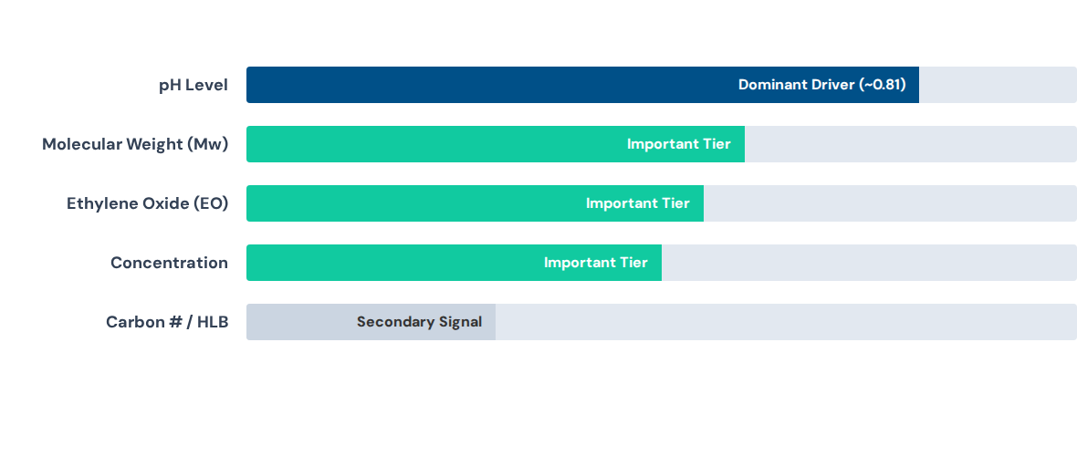
Feature Importance Ranking
pH is the top predictor, clearly differentiating the three media types.

Slide 9
Next Steps
Model Expansion
Interpretation
Optimization
Compare Gradient Boosting, Elastic Net, and SVR models. Analyze performance specifically for each medium scenario.
Report MAE/RMSE metrics. Use SHAP plots to understand how features influence predictions within each distinct medium.
Convert the best model into actionable dosage recommendations for HCl, NaCl, and CPS environments.

